Slide 1


SAP S/4HANA CDS, RAP Training Day 10
Anubhav Oberoy

Slide 2

Agenda – Day 10
Introduction to Managed Scenario
Implementing the Processor
Recap and Testing Composition
--break
Implementing the Action createTravelByTemplate
Implementing the Action approveTravel
Implementing the Action rejectTravel
Modeling Static and Dynamic Feature Control
Implementing Validations
Implementing the Determination
Notes:
https://unsplash.com/photos/CPs2X8JYmS8

Slide 3

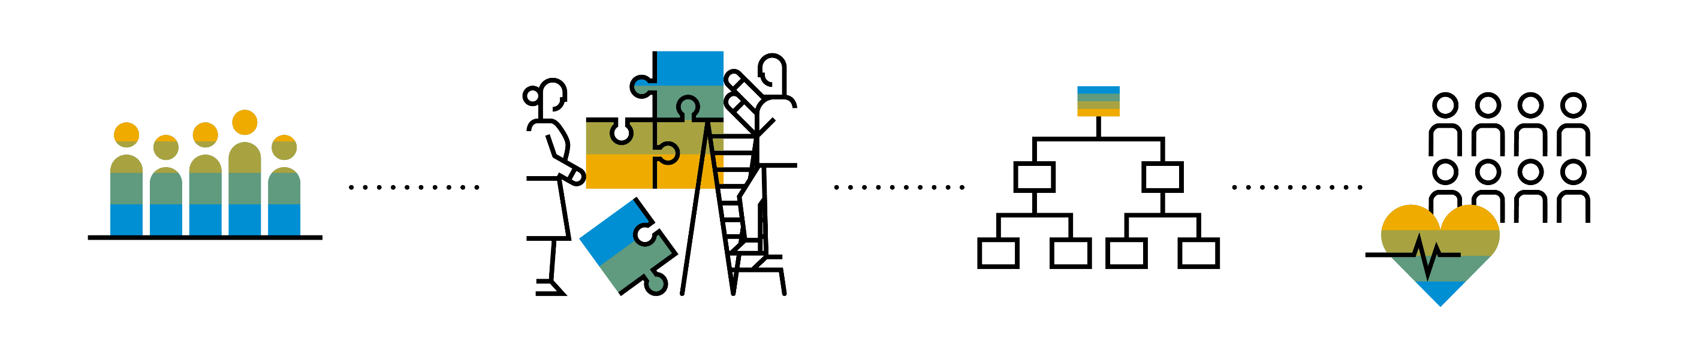
Introduction to Managed Scenario
Let us consider we have been given a green field and asked us to develop a villa from scratch with our own customization. So, what steps will be involved in it? We need to design the floor-plan of the villa, the sections we want to include in the house like pool area, a garden, a jogging track etc. And we will proceed with selecting materials, selecting vendors, enforcing conciliation and orders and many more steps. Similarly, the RAP’s managed scenario provides the greenfield development for our business object.
In the managed scenario, the implementations of behavioral elements like Create/Update/Delete are managed by the RAP framework itself. However, to implement complex logic like validations, determination or some sort of actions (Submit, Approval, Reject etc.) on the business entity, you need to add the ABAP logic for it in implementing classes.

Slide 4



Use Case for Managed Scenario
I am working as a ABAP on Cloud developer for one of the travel planner agency, which has just taken the BTP subscription. They want me to create 2 fiori apps for the travel industry
Processor Application
Approver Application
MakeMyTrip.com
Source → Destination
Start → End Date
How many
Travel Itinerary
Travel Request which has multiple Bookings
Create a travel request and add bookings with all the properties changeable
Updates booking fees and description and provide approvals
Processor
Approver

Slide 5



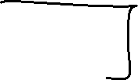









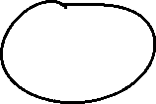











Slide 6

Steps for Build Use Case
Fiori App for Processor
Fiori App for Approver
Service Def and Binding
Service Def and Binding
CDS Data Model
CDS Projection for Processor @UI
CDS Data Model
CDS Data Model
CDS Projection for Approve @UI
Introduction
1..1
Behavior Def
Projection (processor)
Behavior definition
Behavior definition
Behavior Def
Projection (approver)
Behavior definition
Behavior Implement (pool)

Slide 7
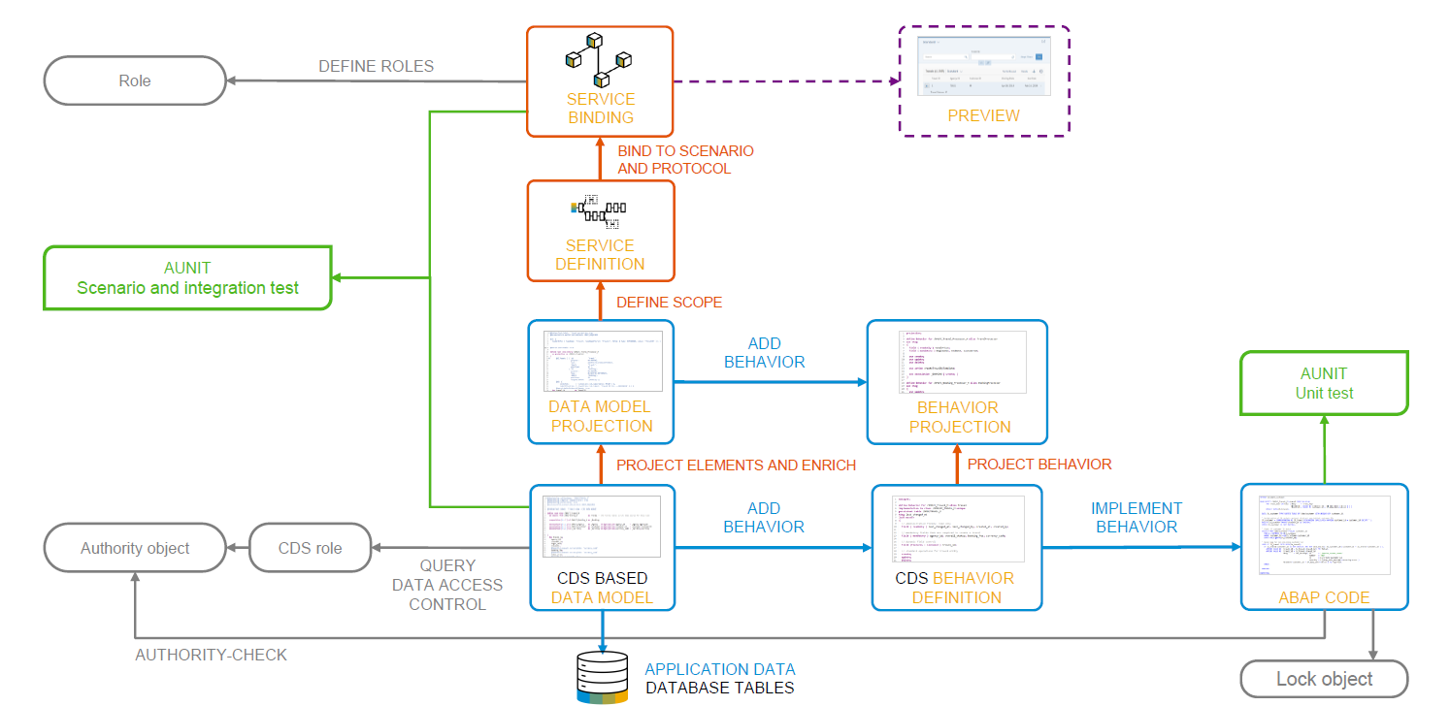
Development flow

Slide 8
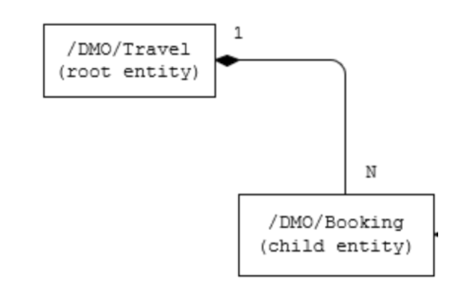
Our new Business Object
From a structural point of view, a business object consists of a tree of entities that are linked by compositions. Every entity in this composition tree is an element that is modeled with a CDS entity. For our demo travel booking scenario, we will implement a 2-level hierarchy composition tree.
As depicted in the figure below, the 2-tier entity hierarchy for managing transactional data in our scenario consists of the following editable entities, with a 1: N cardinality on each level:
Travel
Booking
i.e. each travel instance has 0..N bookings The figure below shows the composition relationship between the travel and the (flight) booking entities, where the travel entity represents the root of the data model.

Slide 9
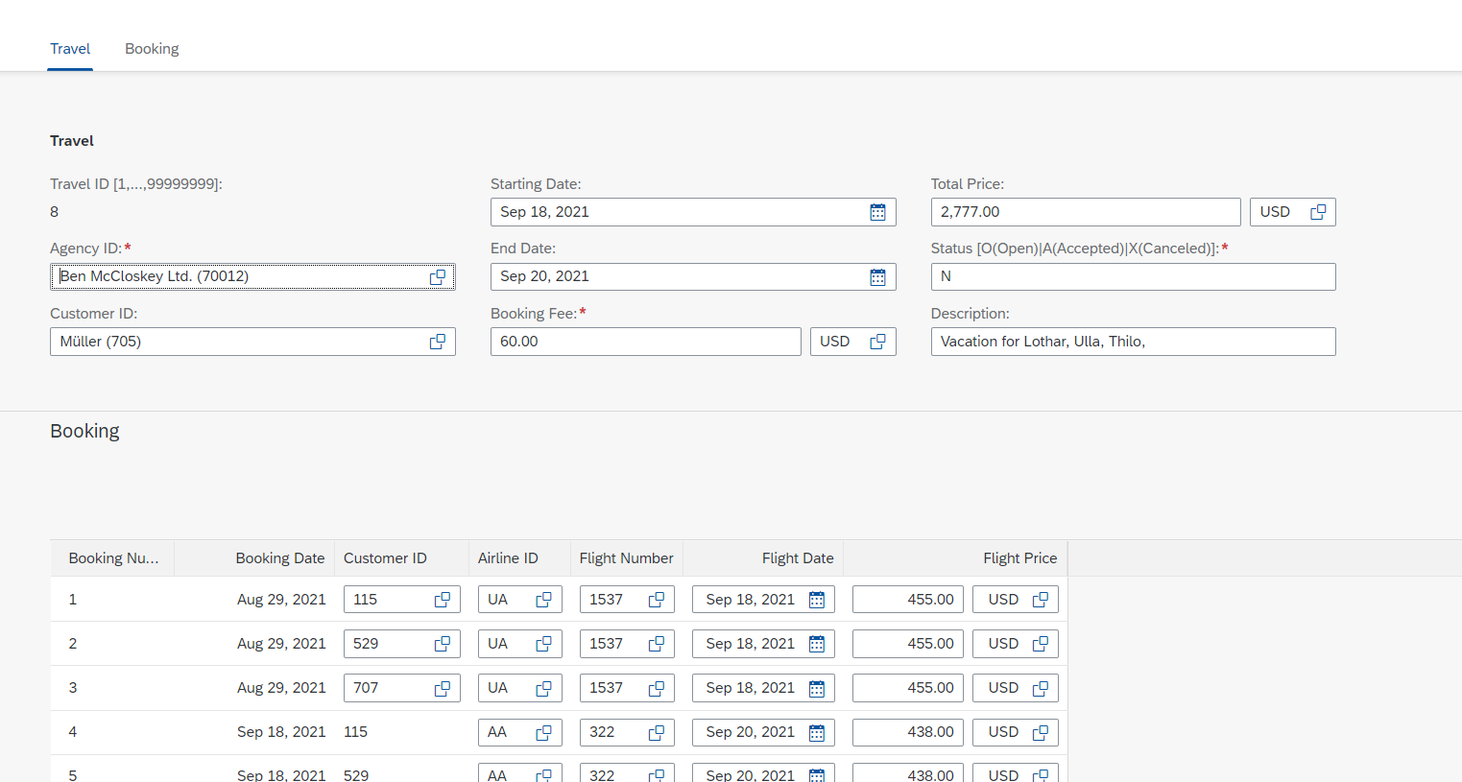
Testing composition
We should be able to create Travel request with bookings.

Slide 10





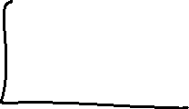

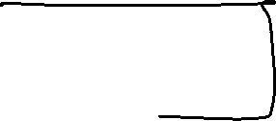



Association v/s Composition
Relationship between classes
Association – Lose Coupling, both objects can work independently, should have relation.
Composition – tight coupling, both objects cannot work independently, must have relation.

Slide 11
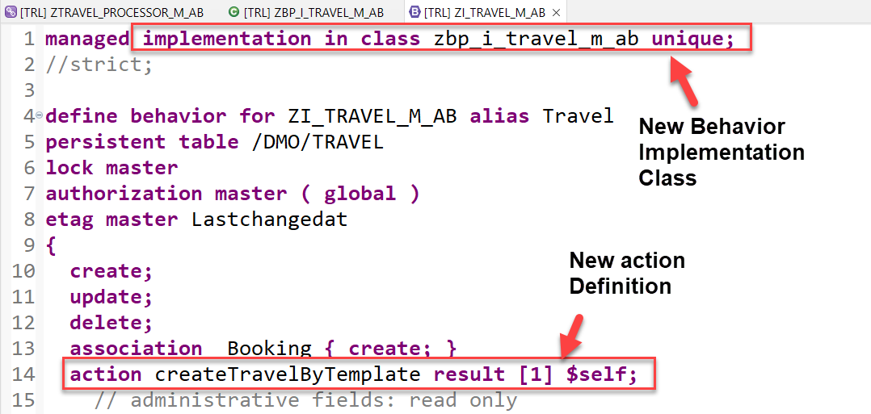
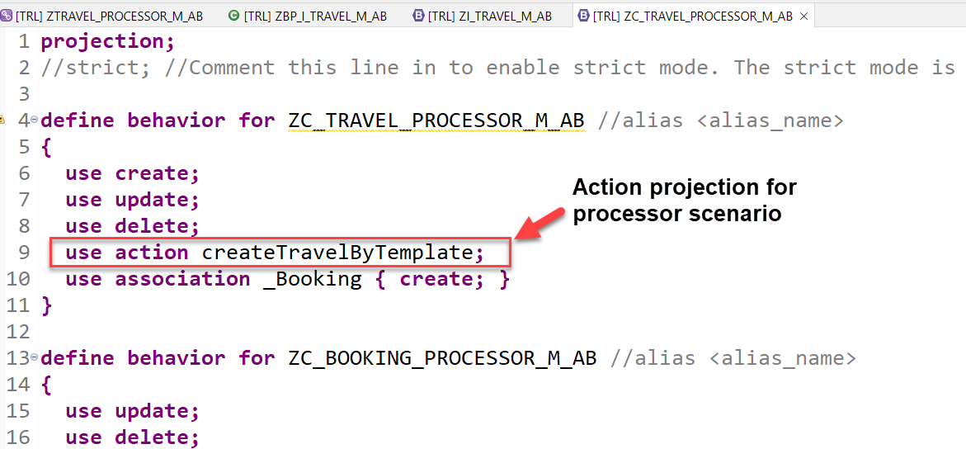
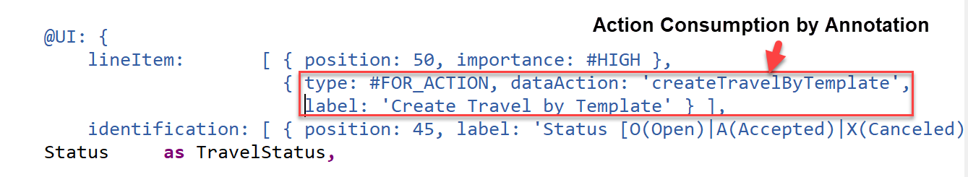
Implementing Action “createTravelByTemplate”
This action provides a template for creating a new travel based on an already existing travel instance.
Exercise
Create Travel By Template Action Code

Slide 12
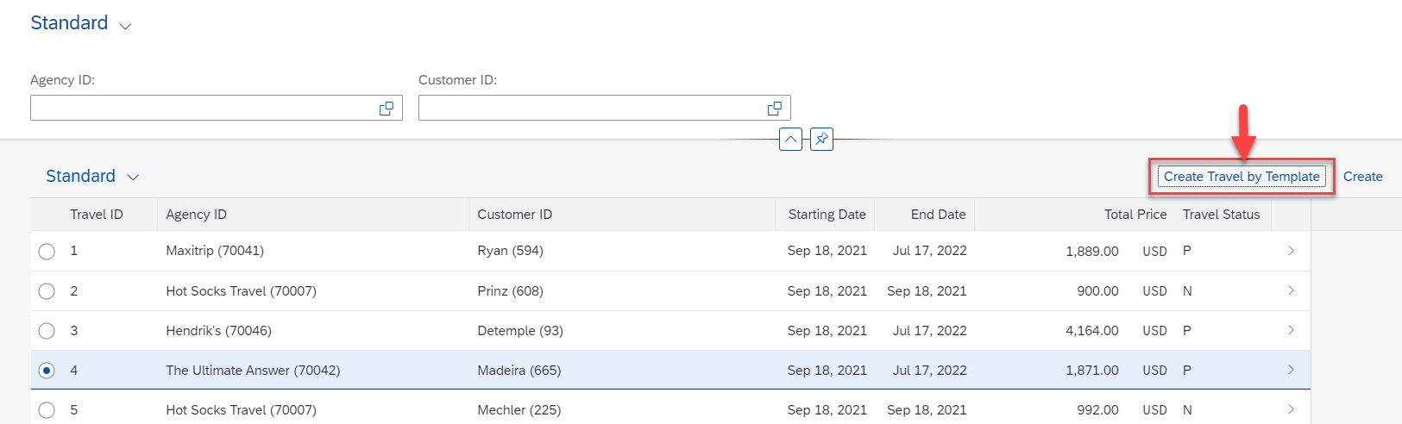
Result of Action Implementation
Check how the UI of a Fiori application looks like or refresh the browser where Fiori app is displayed.

Slide 13
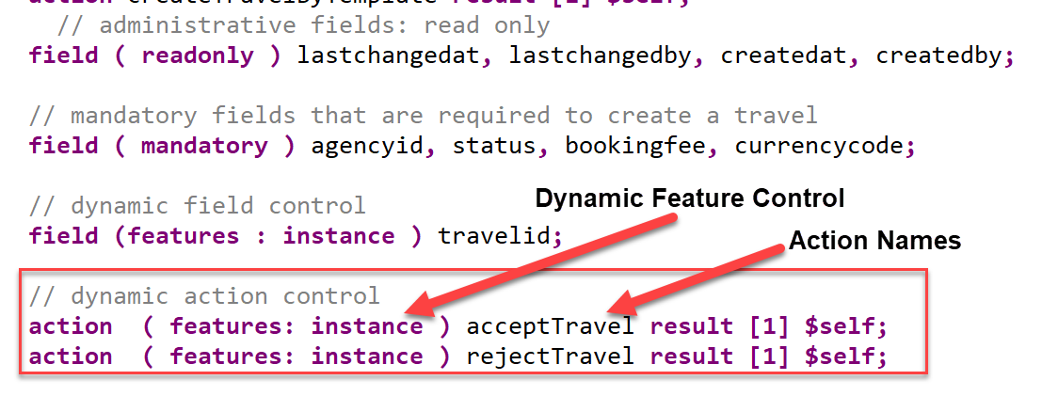
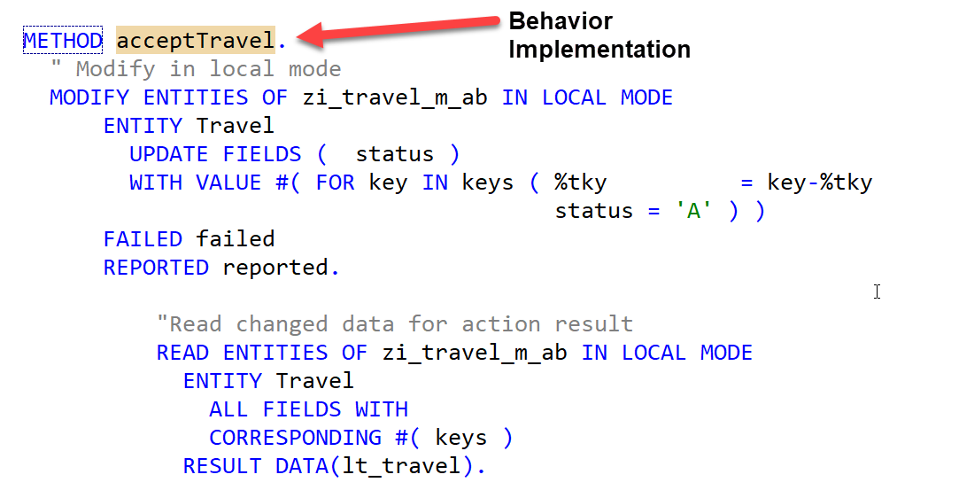
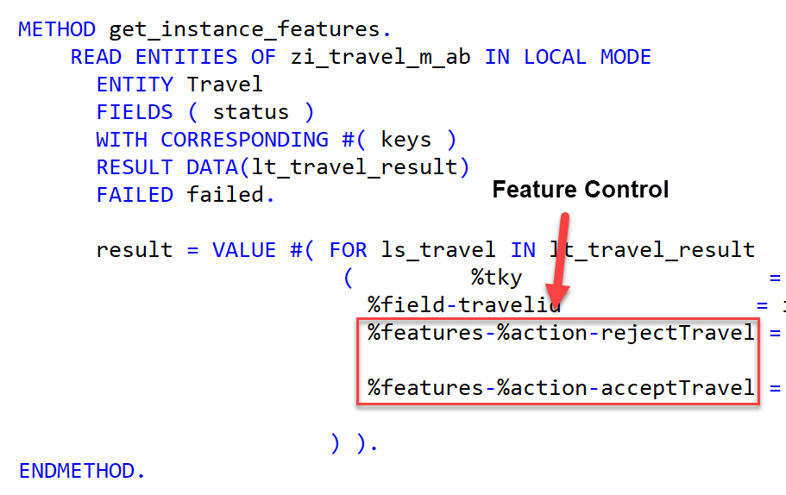
Implementing Action “approve/rejectTravel”
These 2 actions are going to be used later in approver scenario and also have dynamic feature control
Exercise
Approve/Reject Action Code

Slide 14
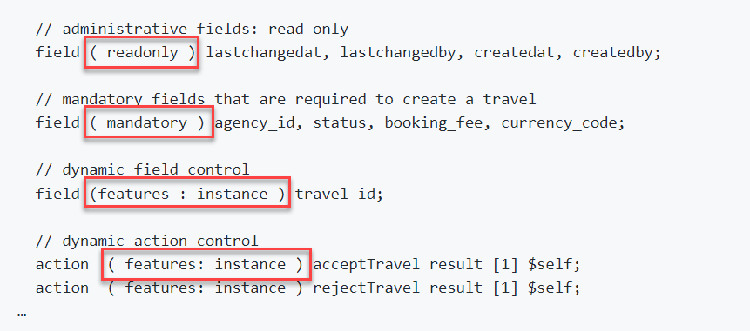
Modeling Static and Dynamic Feature Control
As an application developer you may want to determine, which entities of your business object should be create-, delete- and update-enabled, so that they can be modified during consumption using EML or OData services. In addition, you also may want control which (UI) fields of an entity are read-only or which actions in which usage scenarios are enabled or disabled for execution by the end users.
In ABAP RESTful programming model, the feature control is precisely the means of accomplishing such tasks. It allows you to control the visibility and changeability of fields, operations or entire entities.
Depending on whether feature control refers to specific instances or is independent of each entity instance, we distinguish between instance-bound and static feature control.
The availability of feature control values is modelled in a behavior definition. Unlike static, instance-bound feature control requires not only a definition but also an implementation in a handler class of the behavior pool. Therefore, we also talk about dynamic feature control in case of instance-bound feature control.
Both, static and dynamic feature control is defined for different levels (entity, field, or action level) in the behavior definition by using the following syntax:
Exercise
Dynamic Feature Control Code

Slide 15
Requirements
Make Administrative fields for Travel as Read Only
Make Travel Fields Mandatory for booking
Control the Accept and Reject Travel actions based on status
Make Connection fields mandatory for Booking
Control the Customer ID field based on Carrier, For AA make it Read only

Slide 16
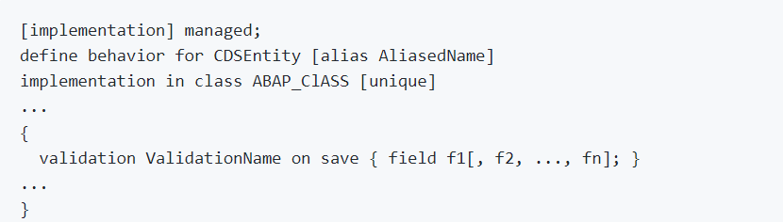
Implementing Validations
A validation is an implicitly executed function intended to check the data consistency of an existing instance of an entity (consistency validation). It is implicitly invoked by the business object’s framework as soon as a trigger condition at a predefined point in time is fulfilled. Validation can return messages to the consumer and reject inconsistent instance data from being saved.
Validations never modify any instance data but return the messages and keys of failed (inconsistent) entity instances.
Validations are specified for individual business object’s entities in the behavior definition by using the following syntax:

Slide 17
Use case for Validation
Check if the customer ID referenced in the Travel order is valid.
Check if the travel end date is more than Travel Start Date
Check if the status passed by User is valid.
These validations are assigned to the "Travel" entity having defined update as the trigger operation on entity "Travel". As soon as data is updated by the consumer, the validation will check it and return a warning message if the unusual condition arrives.
Exercise
Validation Code

Slide 18
Implementing the Determination
A determination is an implicitly executed function that handles side effects of modified entity instances. It is invoked by the business object’s framework as soon as a determination’s trigger condition at a predefined point in time, the determination time, is fulfilled.
Determinations are triggered internally based on changes made to the entity instance of a business object. The trigger conditions are checked by business object framework at different points during the transaction cycle, depending on the determination time and the changing operations on the relevant entity instances. For each determination, it is necessary to specify both the determination time and the changes that form the trigger condition. A trigger condition consists of a list of fields belonging to the same entity the determination is assigned to and the changing operations that include creating or updating entity instances. We call this operations trigger operations.
In case a field is changed (after creation or update), the condition is fulfilled. The framework evaluates the triggering condition of all determinations at certain points in time (determination time). For determinations, this is today either after each modification or during the save phase.
You can use a determination primarily to compute data that is derived from the values of other fields. The determined fields and the determining fields either belong to the same entity or to different entities of a business object.
As a result, determination can modify entity instances and return transition messages (error, warning, information, success).

Slide 19
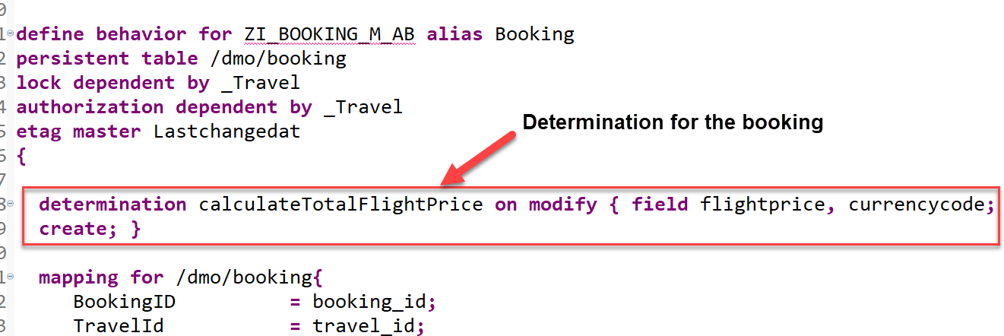
Implementing the Determination
The determination calculateTotalFlightPrice on the booking entity is intended to handle the calculation of total price of all flight bookings that belong to the selected travel.
The determination will be triggered by on modify as determination time when creating new booking instances or updating the flight price value or when changing the currency. In other words: both fields flight_price and currency_code serve as trigger fields and form together with create and update operations the trigger condition for the determination.

Slide 20
Title
Text

Slide 21
Title
Text

Slide 22

Questions?

Slide 23

Thank you
Anubhav.abap@gmail.com
contact@anubhavtrainings.com
+91 84484 54549
www.anubhavtrainings.com

